Slide 1
[Your Centre Name Here]
[Upload your centre logo here]
Introducing Cheqdin
Our New Registrations, Bookings, Payments and Parent Communication Platform
Contact Details: [Name of Manager or Admin]
[Centre’s Email Address]
[Phone Number]
© Copyright - Cheqdin. All rights reserved.

Slide 2
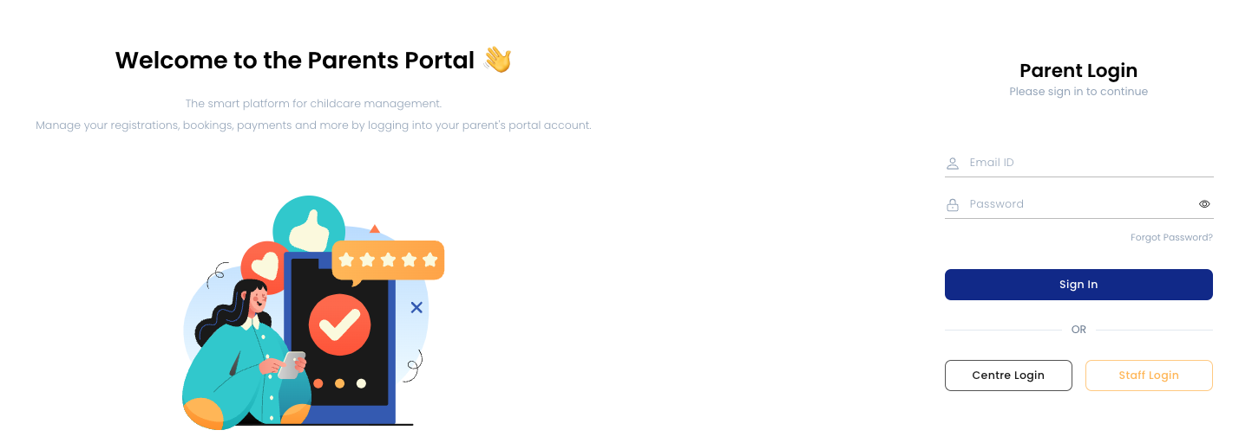
Cheqdin is a web-based smart platform for parent engagement
© Copyright - Cheqdin. All rights reserved.

Slide 3
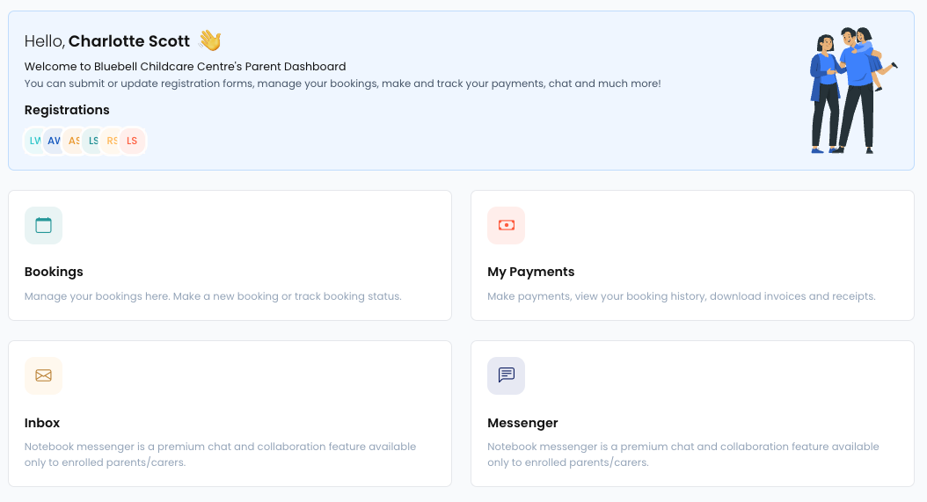
Web-based Parents Portal – Access from any device
With the parents portal, you can:
Register and book with us online
Make payments
Keep track of your invoices and open balance
Send messages and attachments
View upcoming bookings
Update details and manage profiles
© Copyright - Cheqdin. All rights reserved.

Slide 4
Online Enrolment (Registration Forms)
Submit your child’s registration form online with us, view and send messages or track your application.
© Copyright - Cheqdin. All rights reserved.

Slide 5
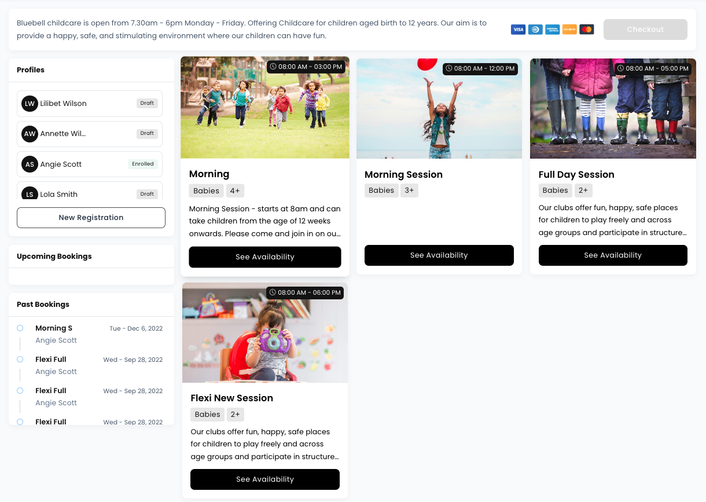
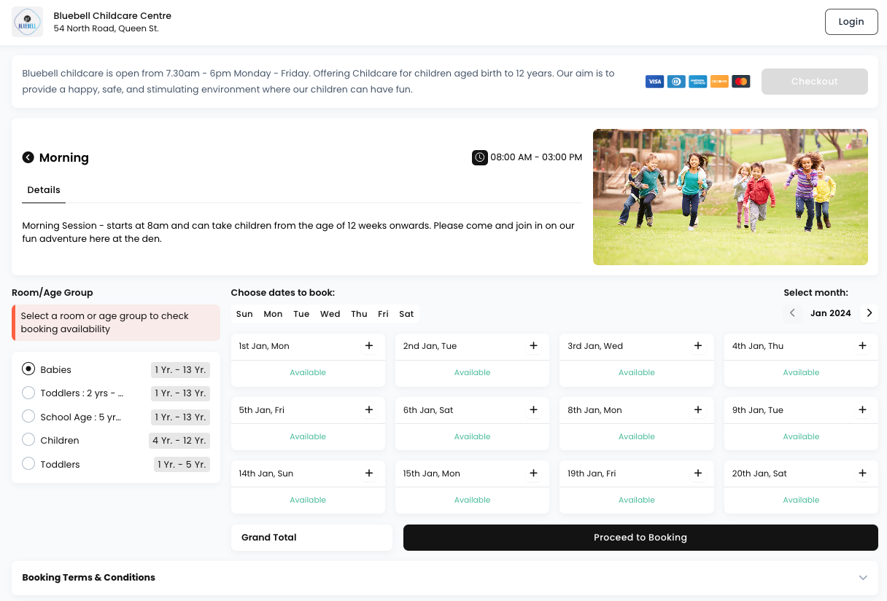
A World-Class Booking Platform
Book your sessions conveniently through your parent portal! You can easily see availability and make a booking.
© Copyright - Cheqdin. All rights reserved.

Slide 6
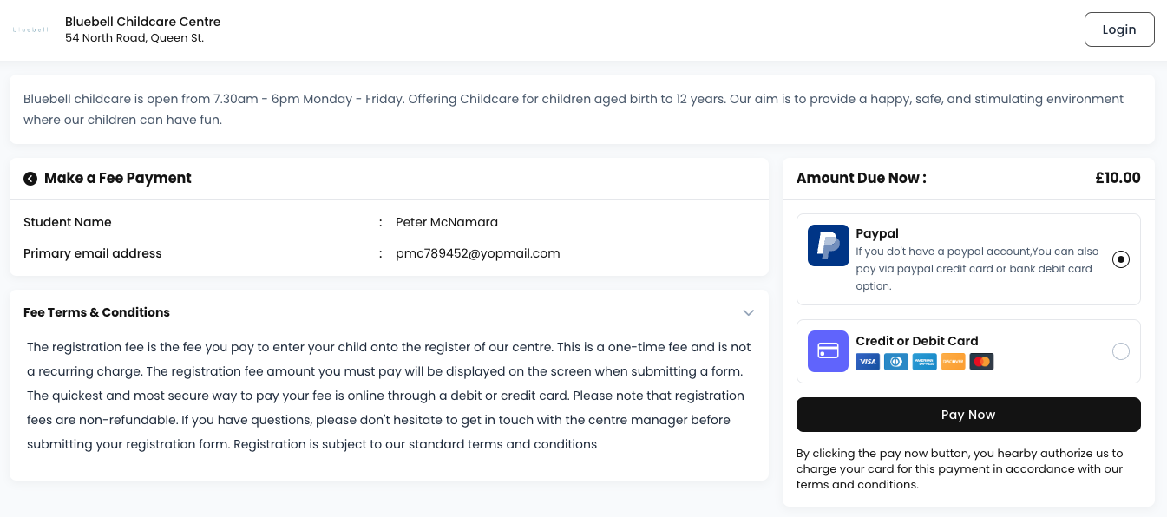
Automated Payments - Pay by debit/credit card or direct debit
Book sessions conveniently from our website and make payments instantly to secure your spot!
© Copyright - Cheqdin. All rights reserved.

Slide 7
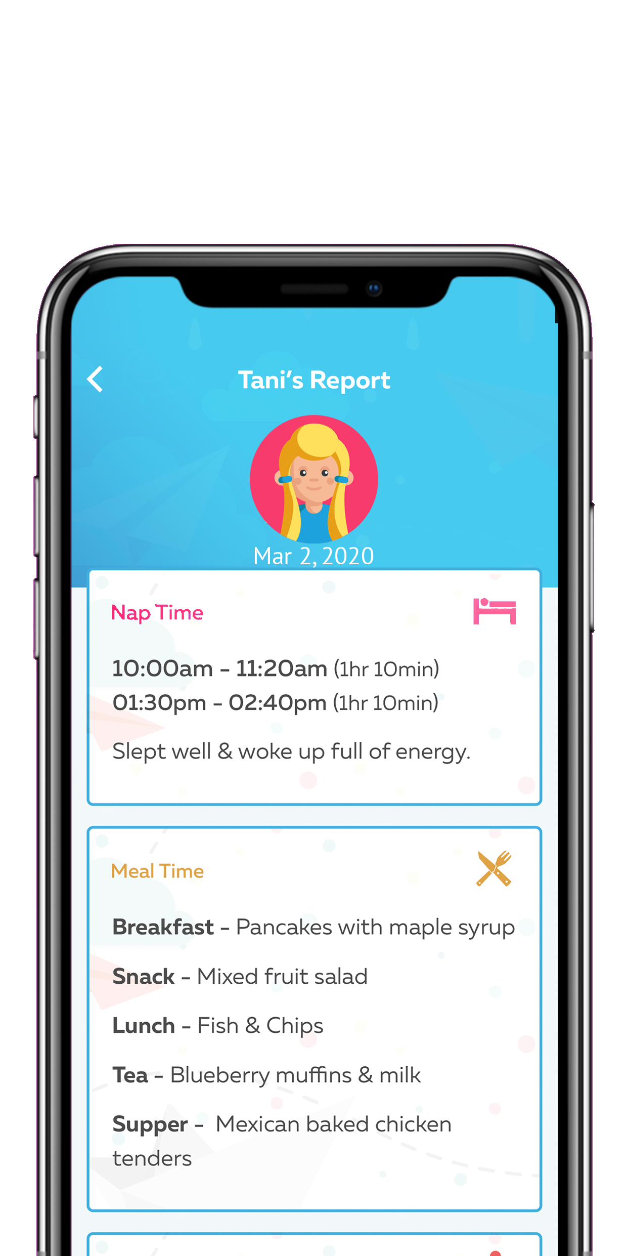
Free Mobile Apps - iOS & Android
See what your child is up to
Get daily updates
Nap, Meals, Activities, Reminders, Toilet etc.
Reports, photos, videos and more
© Copyright - Cheqdin. All rights reserved.

Slide 8
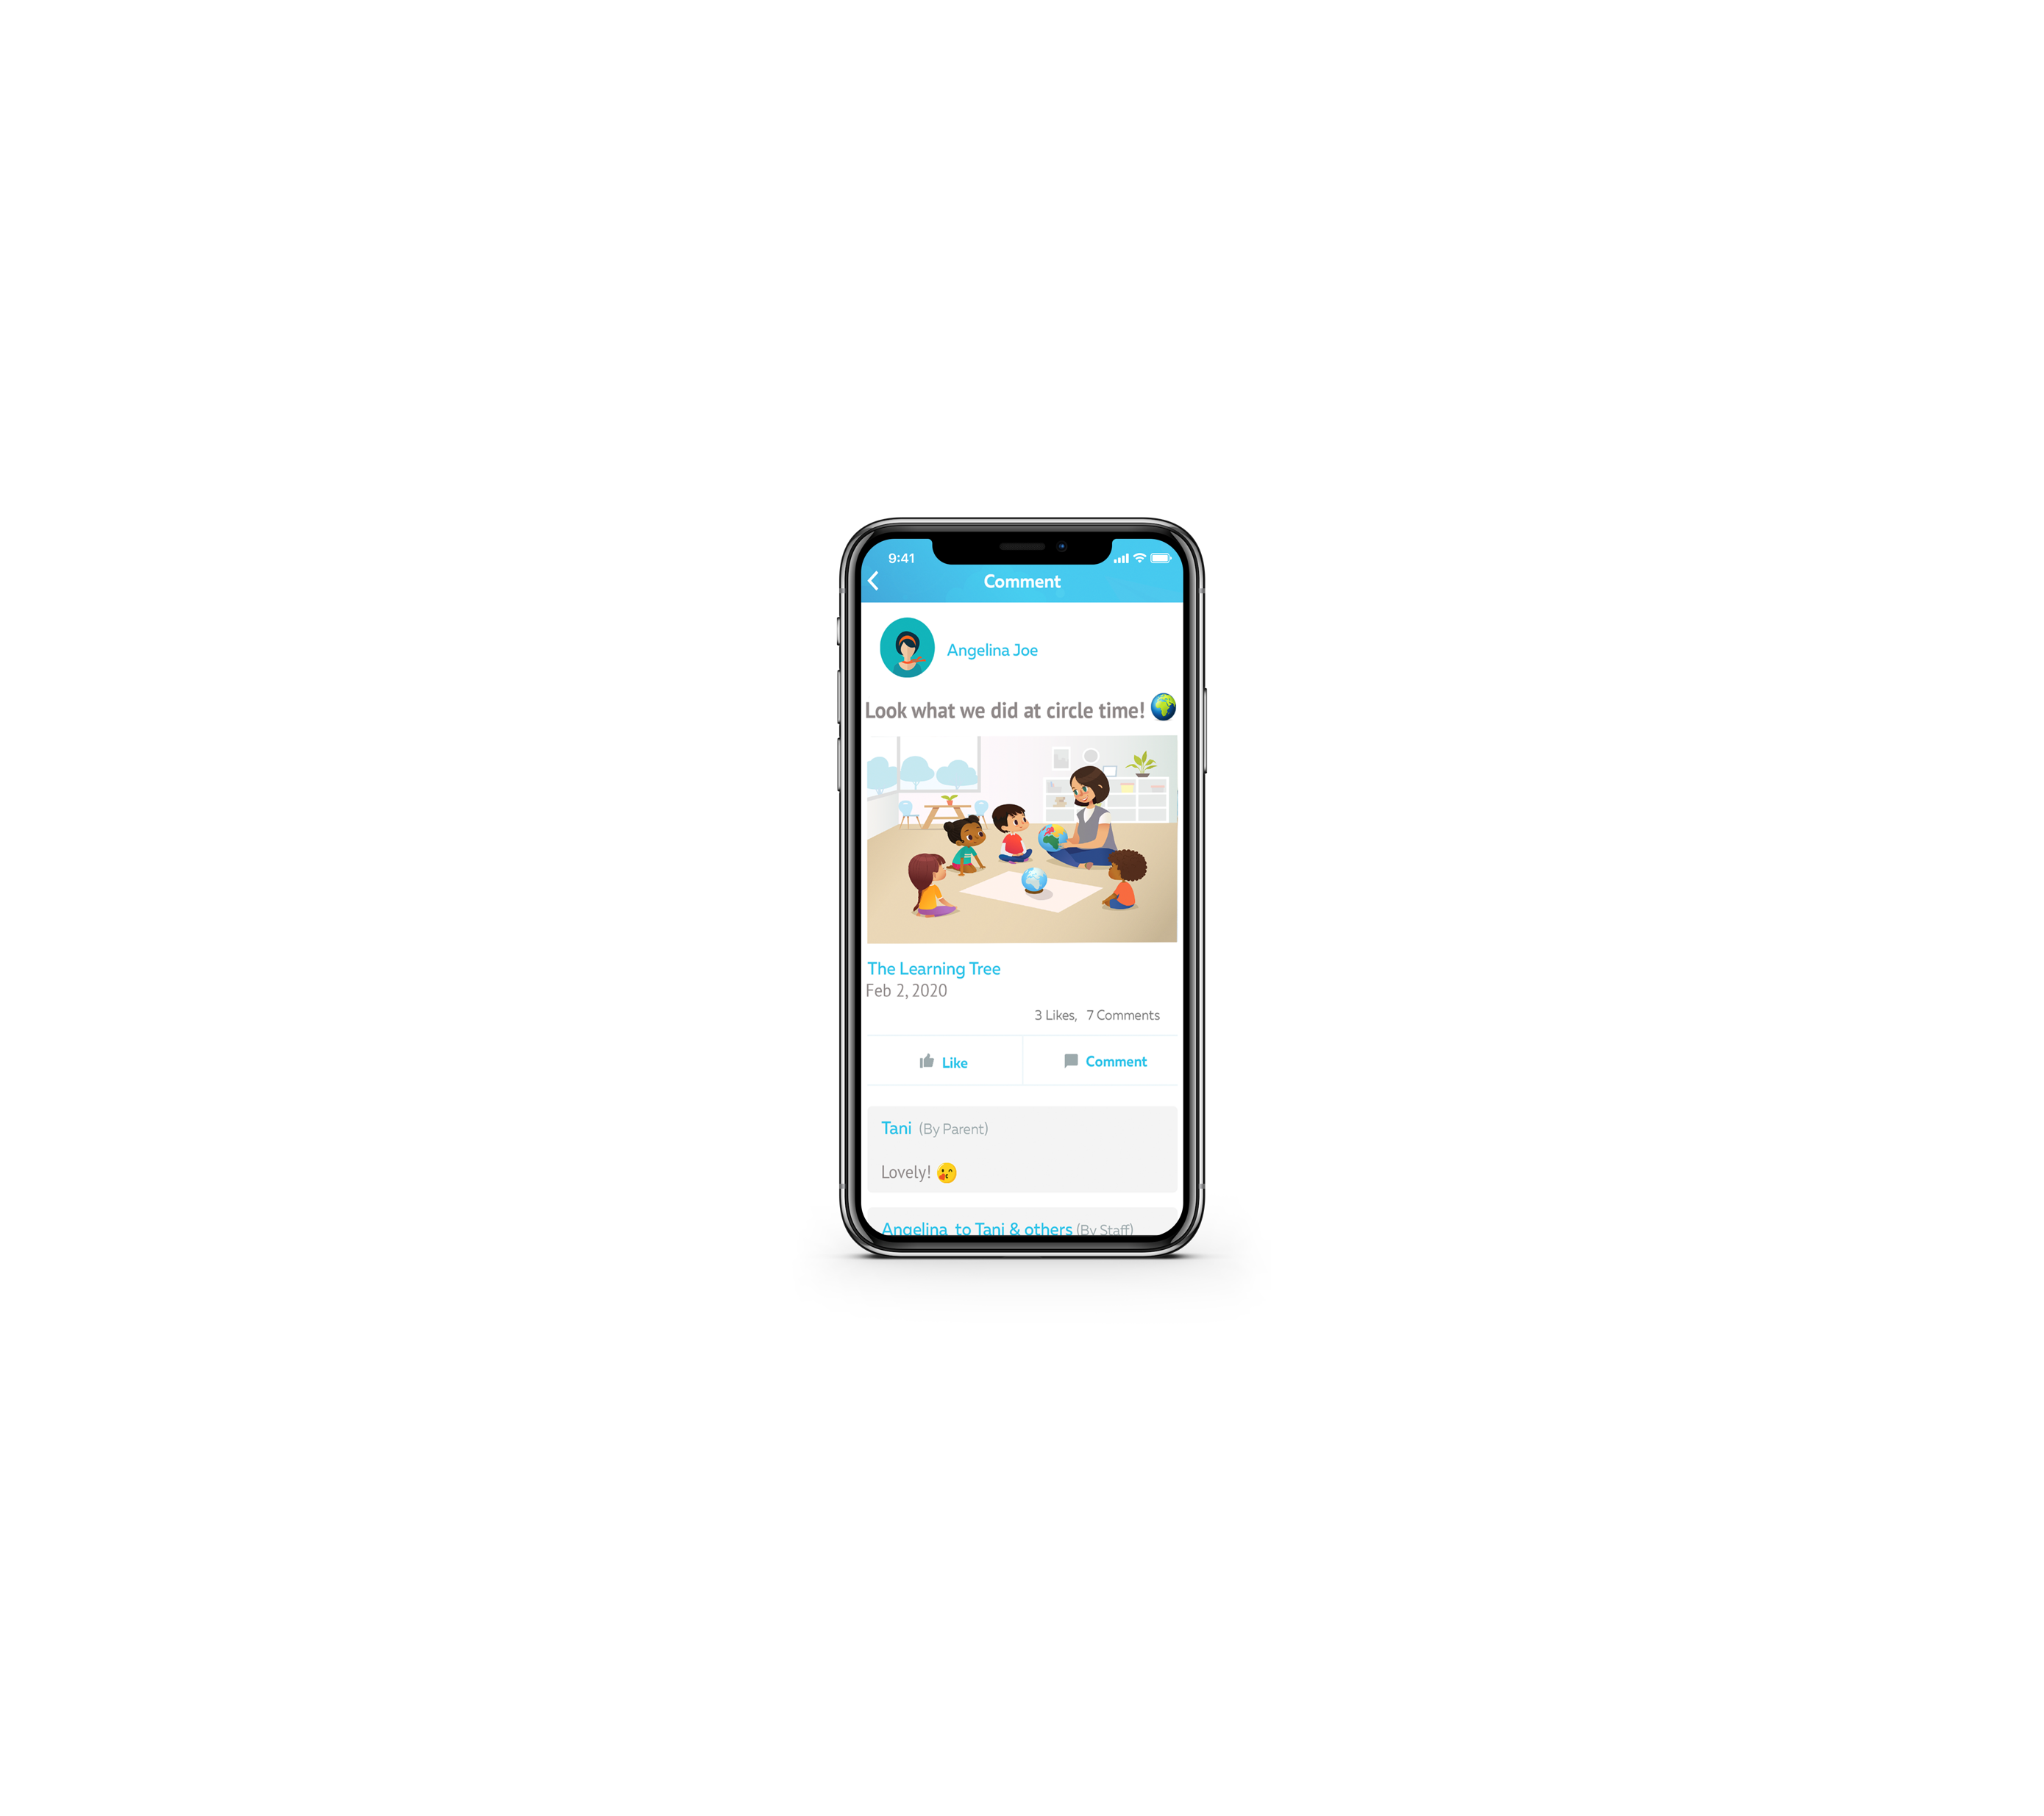
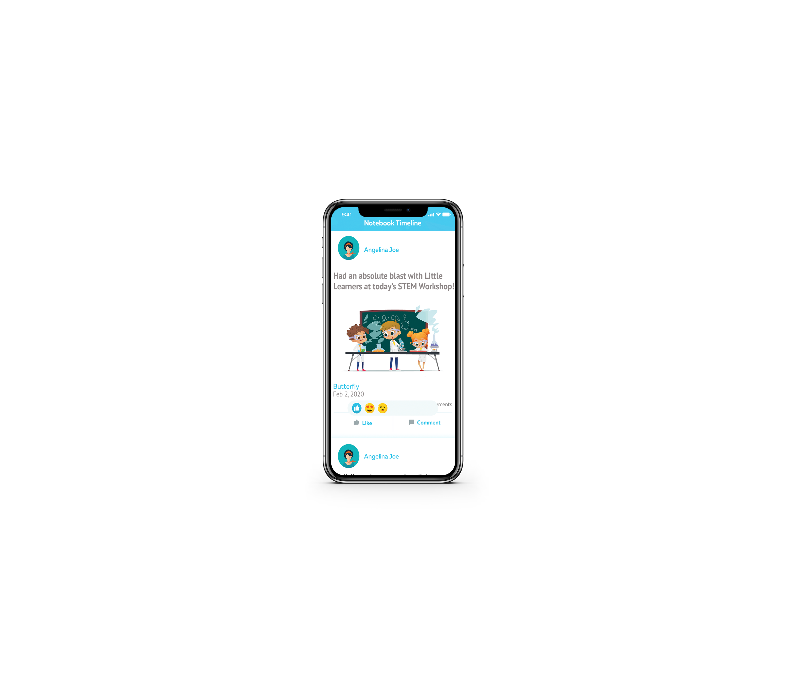
Photo, Video Timelines
Receive activity updates including photos, videos through out the day
© Copyright - Cheqdin. All rights reserved.

Slide 9
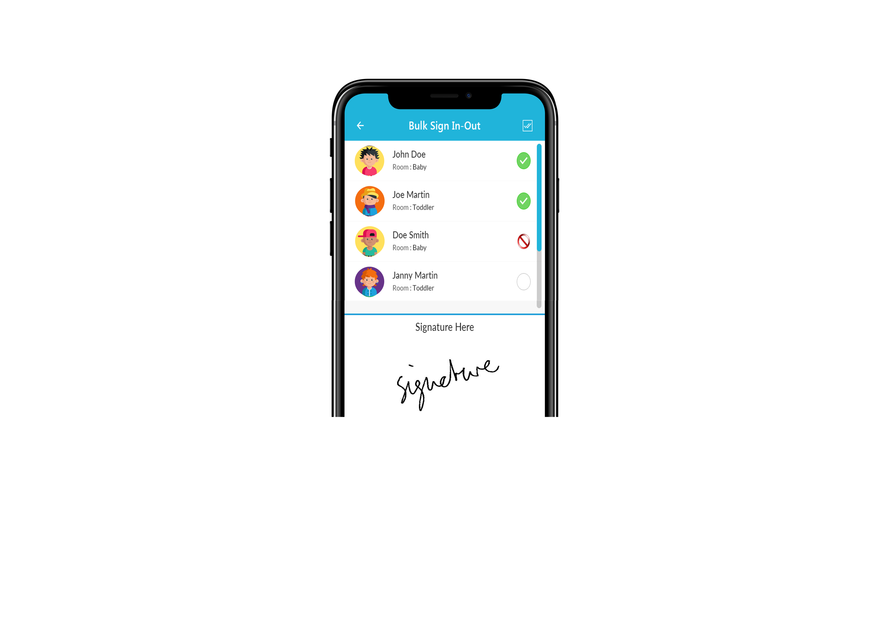
Digital Attendance and sign in-out
Secure 4-digit PIN to sign in-out your child
Both the registered parents will receive a mobile push notification every time your child is signed in or out from our centre.
© Copyright - Cheqdin. All rights reserved.

Slide 10
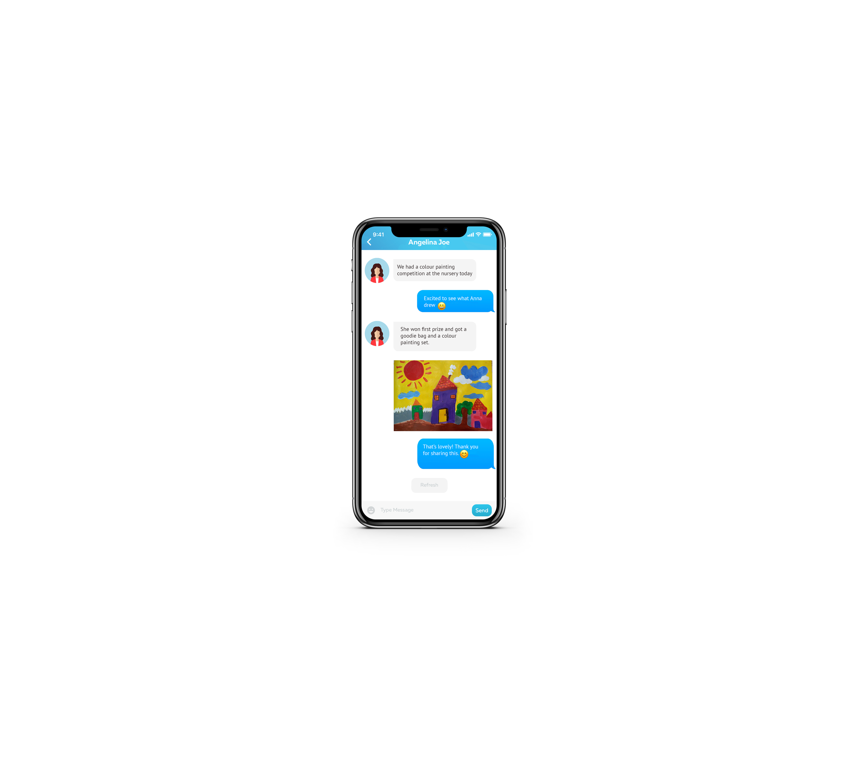
Secure Built-in Chat Messenger
Chat with us through your web portal or mobile apps and get notified whenever you have a new message from us.
© Copyright - Cheqdin. All rights reserved.

Slide 11
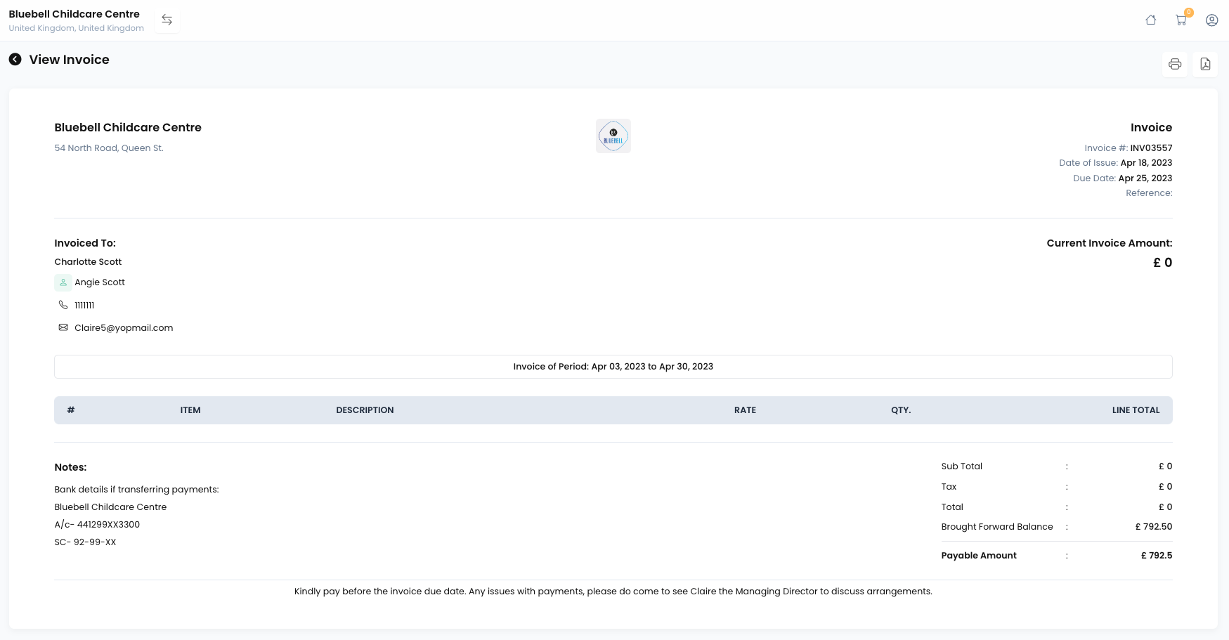
View, print or save invoices and track open balance
View invoices, payment receipts, account balance, and more on the parents portal.
© Copyright - Cheqdin. All rights reserved.

Slide 12
How can I access Cheqdin?
If your child is already enrolled with our centre and you are new to Cheqdin, you will receive your login details via email from the centre.
If you are trying to register with us from our website or via the online registrations link (registration form) for the first time, you will get the email with your logins after you submit your registration form online.
If you have any questions or need help, please contact your centre manager for more details.
© Copyright - Cheqdin. All rights reserved.

Slide 13
Where can I find more information?
If you did not receive the login credentials for your account, get in touch and we can send you a new one. Please be sure to check your junk or spam folders just to make sure that the email did not get caught there.
You can use the same login details for the mobile apps as well as the online parents web portal.
For more information on the Cheqdin app and platform, please visit https://cheqdin.com/parents and https://support.cheqdin.com/support/solutions/folders/48000666422
If you have any questions about your account, please contact your childcare centre manager or admin [Enter centre email address here] directly for further assistance.
© Copyright - Cheqdin. All rights reserved.

Slide 14
System Requirements
Recommended requirements for optimal performance
Internet Speeds
Compatibility:
iOS
Requires iOS 12.0 or later. Compatible with iPhone and iPad.
Android
Requires Version 9.0 or later.
Above 10 Mbps
5-10 Mbps
3 - 5 Mbps
0.5 – 2 Mbps
© Copyright - Cheqdin. All rights reserved.

